Slide 1
Student Seminar - IDP
Presentation 7
Can Ersoy - 10.11.2026

Slide 2
Updated Peptide Sequence Definition
Old: Peptide sequence in letters. (e.g. 'FF')
New: The IUPAC amino acid sequence of the peptide using standard single-letter codes (e.g., 'ACDEFGHIKLMNPQRSTVWY'). Must contain only valid uppercase IUPAC single-letter residues. Do not include spaces, hyphens, numbers.
100 paper sample:
Before: 37/228 sequences valid
Now: 99/160 sequences valid
Sequence count dropped but valid extraction rate increased
There is an edge case (e.g. DIPHENYLALANINE)

Slide 3
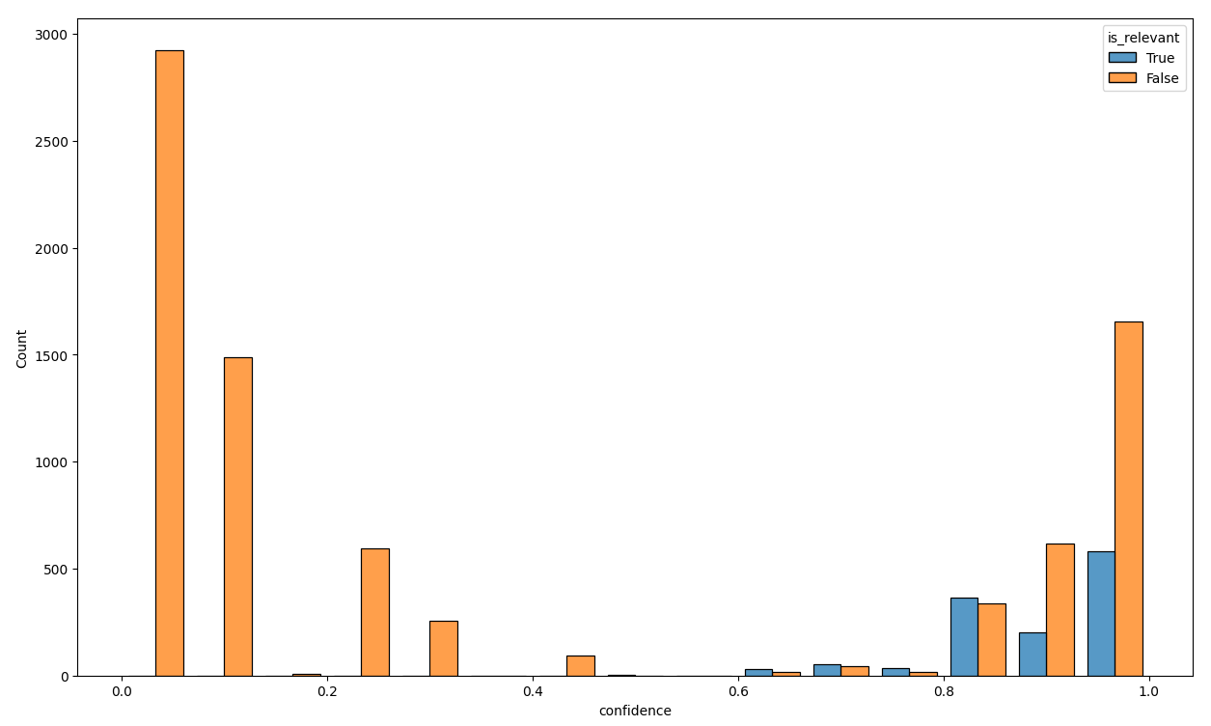
Relevance Check
250 papers sampled (different decisions on relevancy) extractions
Gemini 3.5 Flash Lite: 158 correct (~63%)
Gemma 4 26b: 92 correct (~37%)
Gemini 3.5 flash lite
Notes:
There were 596 papers that had different relevance classification from both models
Out of 250 of these, 75 had no extractions while 175 had (might be invalid not checked)

Slide 4
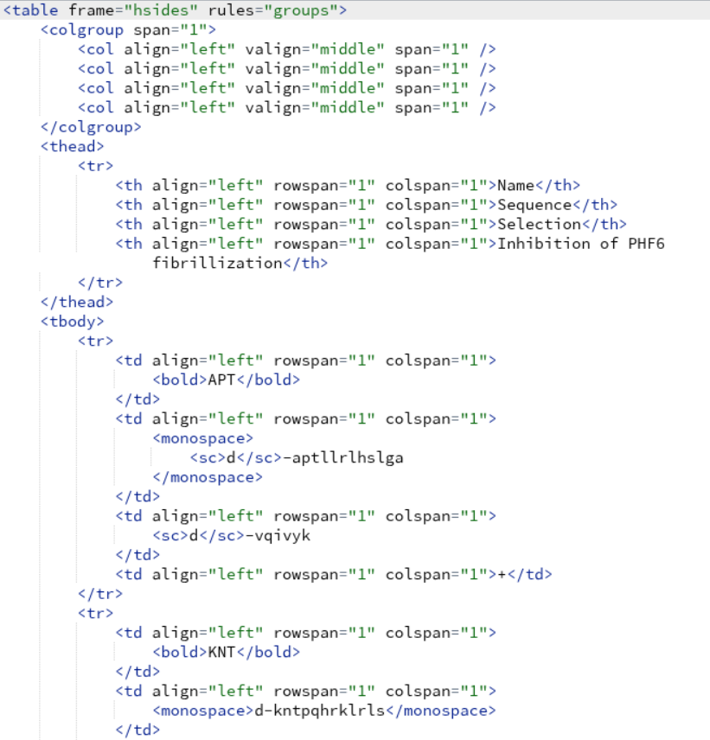
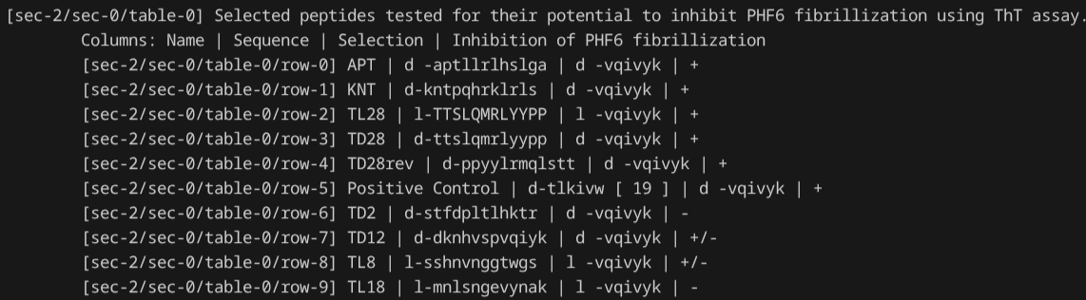
Table Nodes

Slide 5
Table Nodes (2)
Tested the 38 papers with no/low extraction but classified as relevant (from previous weeks)
Paper_id: 257 / had 1 / got 9 (all from a single table)
Paper_id: 958 / had 0 / got 1
Paper_id: 2530 / had 0 / got 9 (all from a single table)
Paper_id: 4936 / had 0 / got 5

Slide 6
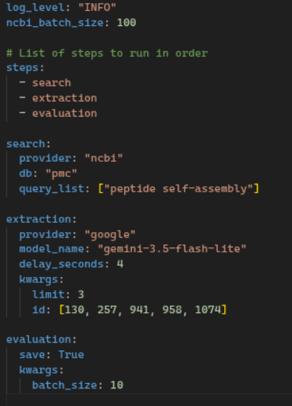
Pipeline Usage
Parameters for individual phases can be added by a YAML file to setup the pipeline

Slide 7
Question about Logging
Which approach is better?
Directory per parts of pipeline (search, extraction etc.) and separate log files with name “{run_identifier}.log” for each phase
or
Combined log file per pipeline run with file name as the program start time
Notes:
First approach:
Cleaner and easier to detailed analysis but harder to do an overall check of the pipeline
Second approach:

Slide 8
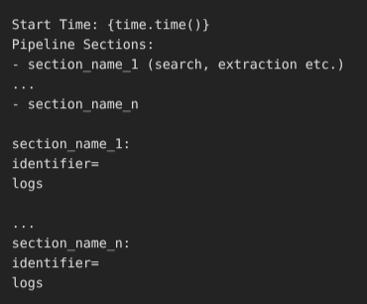

1
2

Slide 9
Next Steps
Add support for non-pmc papers (pdf to llm ready string) -> actually had this TODO few weeks ago but was not a priority at the time
Finish logging

